Slide 1



Payload Aware Network Observability — Praneet Adsumili Dushyant Behl Shachee Mishra Gupta Praveen Govindan Kannan Erich M. Nahum Eran Raichstein Xiping Wang

Slide 2
Idea: Payload Aware Network Observability
Network flow logs only capture data of layers 3 and 4.
Significant additional network observability information exists in the network payload and this data is currently not used for observability. For example, layer 5 protocols include:
BGP, DNS, FTP, HTTP/HTTPS, IMAP, LDAP, NTP, OSPF, RTP, RTSP, SIP, etc.
We know collecting payload data can be resource intensive. Using programmable and selective technology (e.g., eBPF) to retrieve focused packets makes the usage of payload data practical.
Goal is to provide ‘Payload Aware Network Observability’ at minimal cost

Slide 3
Use Cases To Consider
DNS
TLS
HTTP/HTTPS
BGP/OSPF

Slide 4



First Use Case: DNS
DNS protocol is simple, efficient, and used everywhere.
Simple protocol allows complex analysis
Lots of interest in DNS (as evidenced by many startups, including NS1)
Within OCP, DNS packets are not encrypted.
52.200.142.250
www.redhat.com

Slide 5
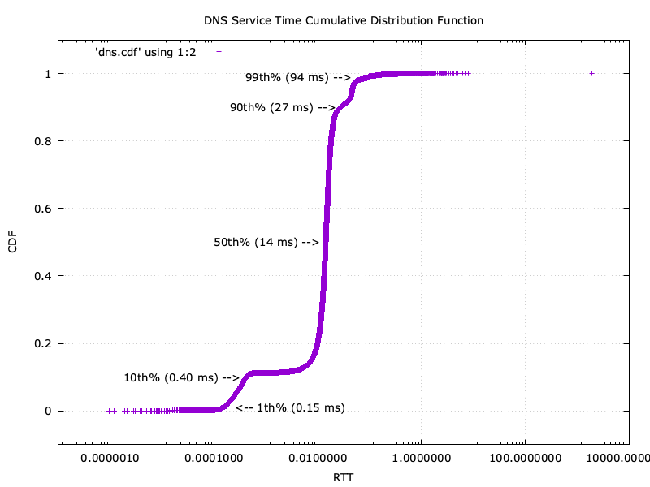
DNS: What Questions can We Answer Looking at Payloads?
What names are being looked up the most?
e.g., www.redhat.com, www.google.com, ns.opendns.com, etc.
What kind of responses are we getting?
e.g., IPV4 (A records), IPV6 (AAAA), redirect (PTR), etc.
What kind of failures do we get?
e.g., domain not found (NXDOMAIN), DNS server failed (SERVFAIL), etc.
What is the latency to serve a DNS req?
From YKT Traffic Sniffer. Note Log X Axis

Slide 6
PANO PoC Architecture for DNS
Service Infrastructure
Observability Infrastructure
eBPF Kernel
eBPF user-
space
DNS
Packets/
Sockets
Flow
Logs
Pipeline
Prometheus
PromQL
Queries
Graphana
DNS
Packets
Zeek
IDS
DNS
Logs
Kafka
DNS
Logs
DNS
Metrics
K-U
Interface
Across
machines
Same
machine
Same
machine
Same
machine
Same
machine
1
2
3
4
5
6
7
Packet Filtering,
Packet Copying
Packet
Aggregation
DNS Protocol processing
M:N
Communication
Enriching,
Annotating,
Transforming,
Storing
Visualizing

Slide 7
Changes to Kernel eBPF and User Agent
eBPF Kernel
eBPF user-
space
Zeek
IDS
Kafka
Flow
Logs
Pipeline
Prometheus
Graphana
Emit full packets instead of flow logs
Add a configurable API to eBPF agent to allow a selection of packets to be filtered:
Original Berkeley Packet Filter:
IP address and port number
New eBPF optimizations:
fixed number of packets that begin each flow (e.g, first 12)
sample of packets from a flow (e.g., 1 in N)
targeted packets from a flow (e.g., DNS query field)

Slide 8


Changes to Zeek: Adding a PCAP over TCP Plugin
eBPF Kernel
eBPF user-
space
Zeek
IDS
Kafka
Flow
Logs
Pipeline
Prometheus
Graphana
Zeek can process live packets or stored traces, known as PCAP files.
Developed a runtime plugin (orthogonal to Zeek version) to support a new option, PCAP over TCP
Informal standard supported by wireshark, tshark, etc.
Allows Zeek to read PCAP files over a socket (local or remote)
Reads the socket produced by eBPF Agent
Installed via the Zeek Package Manager: zkg install zeek-pcapovertcp-plugin
Invoked via a new option: zeek -i pcapovertcp::127.0.0.1:57012
Roughly 800 lines of C++ code
Open-sourced at https://github.com/emnahum/zeek-pcapovertcp-plugin

Slide 9
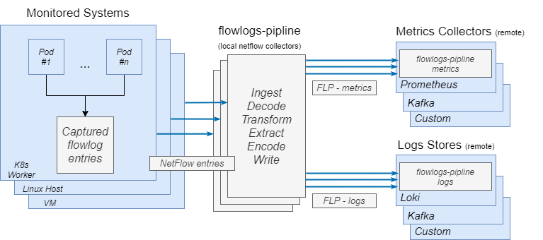

Flow Logs Pipeline: A Tool for Log Transformation
eBPF Kernel
eBPF user-
space
Zeek
IDS
Kafka
Flow
Logs
Pipeline
Prometheus
Graphana
Configuration
Metrics Store
Flow Logs
Transformer
Log Store
Enriches (adds)
Extracts (e.g., GeoIP)
Flow Logs Pipeline (FLP) is a CLI tool that:
Ingests (reads)
Transforms (re-writes)
No code changes, only configuration
Writes (exports to output formats)
https://github.com/netobserv/flowlogs-pipeline

Slide 10
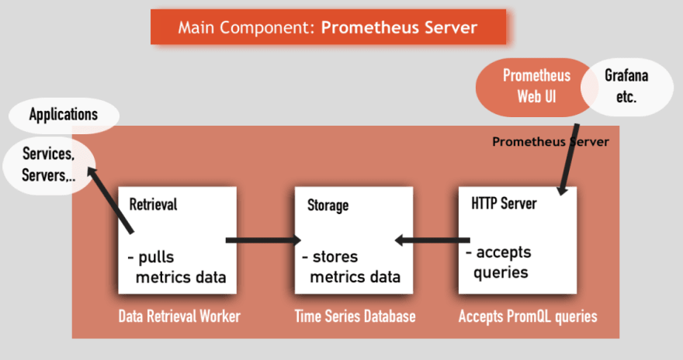
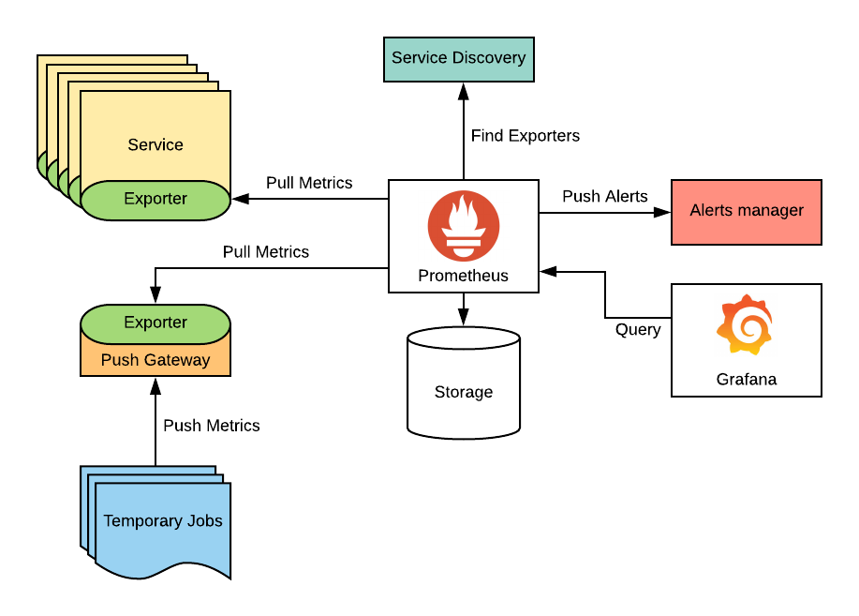


Prometheus: A Tool for Metric Collection
eBPF Kernel
eBPF user-
space
Zeek
IDS
Kafka
Flow
Logs
Pipeline
Prometheus
Graphana
Configuration
(No code changes)
storage is typically a time-series database

Slide 11
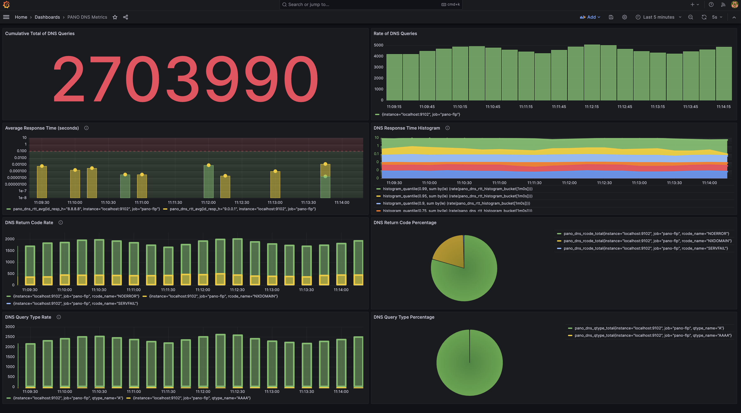


Grafana: A CNCF Tool for Visualization
eBPF Kernel
eBPF user-
space
Zeek
IDS
Kafka
Flow
Logs
Pipeline
Prometheus
Graphana
Configured a PANO DNS Dashboard
(No code changes)

Slide 12
DEMO

Slide 13

Status: Where We Are
eBPF kernel agent:
Enhance to dump full packets into user space
Add a configurable API to allow dumping a selection of packets
eBPF user agent:
Buffer and stream packets to Zeek
Zeek: Added packet input source to handle packets over sockets
Available as a Zeek plugin on http://github.com
Kafka: Minimal configuration required
Flow Logs Pipeline: Configured to process DNS logs
Prometheus / Grafana: Configure to visualize DNS results

Slide 14
Next Steps
Next PoC’s: Other protocols (TLS/SSL, HTTP, BGP)
Refine / improve the performance and architecture of the pipeline
Resource Consumption of use cases (CPU, Memory, Network BW, etc.)
Replace Zeek with something lighter weight?
Remove Kafka from Pipeline?
Direct eBPF to Zeek?
Get feedback from the IBM & RedHat communities

Slide 15
Summary
Payload Aware Network Observability will:
Allow greater visibility into the network by looking at payloads
Reduce the overhead of capturing, transferring, and processing data

Slide 16
Thank you!! Questions?
We can also be reached via :
IBM slack # pano
RH slack # forum-network-observability

Slide 17
BACKUP/MASTER SLIDES

Slide 18
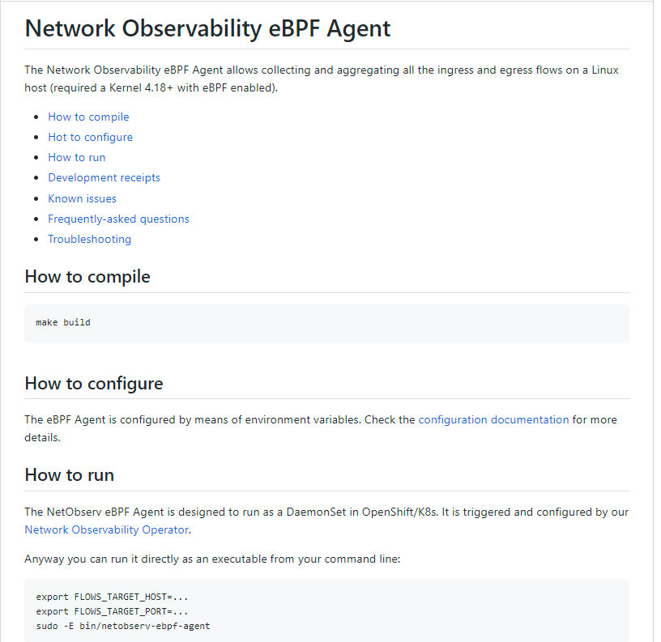
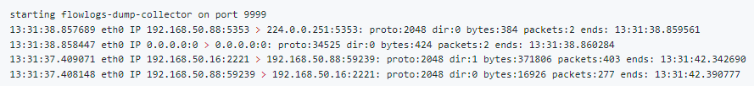
What is eBPF?
eBPF Kernel
eBPF user-
space
Zeek
IDS
Kafka
Flow
Logs
Pipeline
Prometheus
Graphana
eBPF is a revolutionary technology with origins in the Linux kernel that can run sandboxed programs in an operating system kernel. It is used to safely and efficiently extend the capabilities of the kernel without requiring to change kernel source code or load kernel modules.
Network Observability details:
Using tc (traffic control) eBPF hook
User space in golang, Kernel in C
Simple conf (exclude/include interfaces etc … )
Capture flows
../examples/flowlogs-dump
https://ebpf.io/
https://github.com/netobserv/netobserv-ebpf-agent

Slide 19
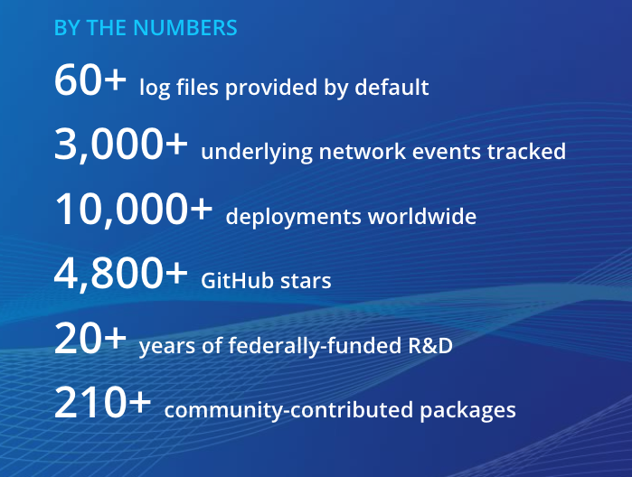
What is Zeek? An Intrusion Detection System
eBPF Kernel
eBPF user-
space
Zeek
IDS
Kafka
Flow
Logs
Pipeline
Prometheus
Graphana
An open-source network security monitoring system.
Has a BSD License.
Primarily used as an intrusion detection system (IDS).
Analyzes network traffic in real time and generates high-level, human-readable network logs that provide detailed insights into network activity.
Has a large and active user community, and it is widely used by security teams in a variety of industries, including government, finance, healthcare, and technology.
http://www.zeek.org
Modification: Added support to read PCAP files over TCP sockets

Slide 20
Second Use Case: SSL/TLS
CLIENT
SERVER
1
TCP SYN
TCP SYN-ACK
2
Capture only first N packets in each new TLS session (not a lot of packets)
E.g., N=12
Or specify range, e.g., [4:11]
Keep state per session in eBPF
Identify TLS/SSL Information, e.g.:
TLS version
Cipher spec
Key Size
Certificate validation status
Session resumed status
Plain TCP
3
TCP ACK
4
CLIENT HELLO
TLS over TCP
ACK
5
SERVER HELLO, CIPHER SUITE
6
Example:
https
packet
exchange
SERVER CERTIFICATE
7
CERT STATUS,
SRV KEY EXCH,
HELLO DONE
8
9
ACK
CLIENT KEY EXCH,
CHG CIPHER SPEC,
HANDSHAKE MSG
10
NEW SESSION TCKT,
CHG CIPER SPEC,
HANDSHAKE MSG
11
Notes:
Verification of public key based on CA public key: public key decryption
Server receives the pre_master_secret client encrypted using server public key: private key decryption
Server verify Client certificate: public key decryption
Client verify server signs the digest handshake messages which the server needs to decrypt using client public key: public key decryption
Client signs: private key encryption
TLS Cost Interpretation
Private key operations (digital signature and private key decryption), public key operations (signature verification and public key encryption). Private key operations are much slower than public key operations, all private key operations with a given key size take pretty much the same time, as do all public key operations with a given key size.
Certificate: S->C S: Server sends its X.509 Certificate which is signed by a trusted CA; C: Client parses and verifies the certificate using pre-configured CA public key; (public key decryption)
ClientKeyExchange: C->S C: pre_master_secret encrypted under the server's public key (public key encryption). S: private key decryption of pre_master_secret. This is the SSL bottleneck. the server's RSA key length is the most important factor limiting performance in this mode.
Mutual authentication:
CertificateRequest: S->C indicate to the client that client authentication is enabled and provides guidance as to what sorts of certificates the server is willing to accept, such as the cryptographic algorithm that should be used and a list of the certificate authorities which it trusts to sign client certificates.
Certificate: C->S C: sends CA signed client public key. S: Server parses and verifies the certificate using pre-configured CA public key (public key decryption).
CertificateVerify: C->S C: the key of client authentication. It contains a digest of the handshake messages signed by the client's private key. compute the hashes of the handshake messages: MD5 and SHA-1. The signed object is the concatenation of MD5 and SHA-1 digests of the handshake messages up to this point in the handshake. (private key encryption) S: checking the client's digital signature using client's public key (public key decryption).
book p. 188 The total computational cost of client authentication mode is roughly double othat of server-only authentication, this cost is borne disproportionaately by the client. In this case, the cost to the server is roughly 20% of that of the client. As a result, using client authentication substantially increases latency (because of the slower client) but has a much smaller effect on throughput (because the server is not that much affected).
RSA key size:
When we talk about the key length of an RSA key, we are referring to the length of the modulus, n, in bits. The minimum recommended key length for a secure RSA transmission is currently 1024 bits. A key length of 512 bits is now no longer considered secure, although cracking it is still not a trivial task for the likes of you and me. The longer your information is needed to be kept secure, the longer the key you should use. Keep up to date with the latest recommendations in the security journals.
There is small one area of confusion in defining the key length. One convention is that the key length is the position of the most significant bit in n that has value '1', where the least significant bit is at position 1. Equivalently, key length = ceiling(log2(n+1)). The other convention, sometimes used, is that the key length is the number of bytes needed to store n multiplied by eight, i.e. ceiling(log256(n+1)). The key used in the RSA Example paper [KALI93] is an example. In hex form the modulus is
0A 66 79 1D C6 98 81 68 DE 7A B7 74 19 BB 7F B0 C0 01 C6 27 10 27 00 75 14 29 42 E1 9A 8D 8C 51 D0 53 B3 E3 78 2A 1D E5 DC 5A F4 EB E9 94 68 17 01 14 A1 DF E6 7C DC 9A 9A F5 5D 65 56 20 BB AB The most significant byte 0x0A in binary is 00001010'B. The most significant bit is at position 508, so its key length is 508 bits. On the other hand, this value needs 64 bytes to store it, so the key length could also be referred to by some as 64 x 8 = 512 bits. We prefer the former method. You can get into difficulties with the X9.31 method for signatures if you use the latter convention.

Slide 21
TLS: What Questions can We Answer Looking at Payloads?
Is our environment “secure”, i.e., is there any unencrypted traffic?
E.g., we see no unencrypted HTTP or DNS traffic.
Is the version of TLS we are using up-to-date?
TLS 1.0, 1.1-- NO
TLS 1.2, 1.3 -- YES
Are the versions of Cryptography that we’re using up-to-date?
TLS_DH_RSA_WITH_DES_CBC_SHA - NO
TLS_RSA_WITH_RC4_128_SHA - WEAK
TLS_RSA_WITH_AES_384_CBC_SHA – GOOD
Do we have signs of being compromised?
IP address 1.2.3.4 seems to be running a port scanner (nmap/nessus)

Slide 22
DNS Packet Analysis Tools
Tool | Multi- Protocol? | High Level? | Server Agnostic? | URL
Zeek | Yes | Yes | Yes | http://www.zeek.org
Suricata | Yes | No | Yes | https://suricata.io/
Wireshark/Tshark | Yes | No | Yes | https://www.wireshark.org/
Prometheus Plugin | No | Yes | No | https://github.com/DNS-OARC/PacketQ
DNStap Plugin | No | Yes | No | https://dnstap.info/
DNSMonster | No | Yes | Yes | https://dnsmonster.dev/
PassiveDNS | No | Yes | Yes | https://github.com/gamelinux/passivedns
GoPassiveDNS | No | Yes | Yes | https://github.com/Phillipmartin/gopassivedns
PacketQ | No | Yes | Yes | https://github.com/DNS-OARC/PacketQ

Slide 23






Red Hat’s Network Observability Focus
Six Functional Areas:
Network flow visibility
Network tracing
What traffic is flowing in, around, and out of my network?
What path does specific traffic take through various interfaces to its final destination?
Network topology
Network policy
What physical and virtual resources are connected to my network?
Rules governing the flow of traffic in, around, and out of my network
Network metrics
Network traffic capture
High-level performance metrics to indicate the overall health of my network
Capture + mirror to an external location for debugging, audit, or lawful capture
Notes:
Provide insight into network traffic
Troubleshoot networking issues
Network capacity planning
Policy validation
Identify security risks (in cooperation with ACS)
Generate reports
Auditing
Preventive measures

Slide 24
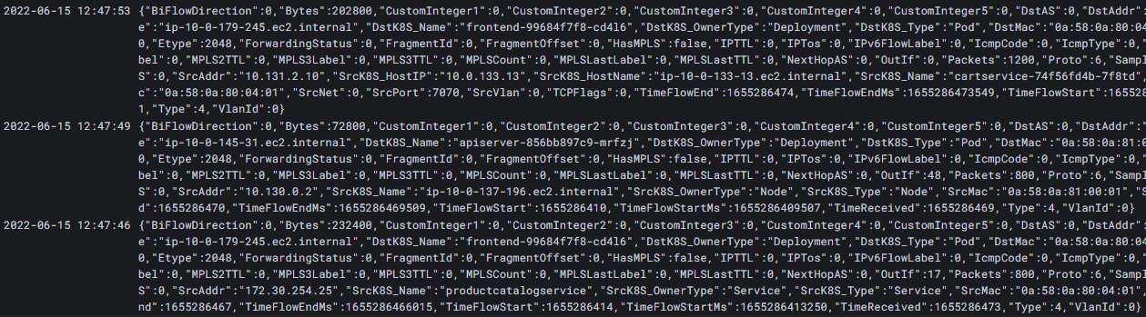
Example: Flow Logs (e.g., net-flows)
Among various types of network related operational data (bulk counters, packet capture, network device logs) flow logs are:
More informative than bulk counters while more concise and viable than full packet capture
Often must be collected due to regulatory and compliance requirements, such as auditing
However, flow logs do not capture payload data

